Slide 1
Chapter 5: Process Synchronization
Notes:
‹#›

Slide 2
Background
Processes can execute concurrently
May be interrupted at any time, partially completing execution
Concurrent access to shared data may result in data inconsistency
Maintaining data consistency requires mechanisms to ensure the orderly execution of cooperating processes
Illustration of the problem: Suppose that we wanted to provide a solution to the consumer-producer problem that fills all the buffers. We can do so by having an integer counter that keeps track of the number of full buffers. Initially, counter is set to 0. It is incremented by the producer after it produces a new buffer and is decremented by the consumer after it consumes a buffer.
Notes:
‹#›

Slide 3
Producer
while (true) { /* produce an item in next produced */
while (counter == BUFFER_SIZE) ;
/* do nothing */
buffer[in] = next_produced;
in = (in + 1) % BUFFER_SIZE;
counter++;
}
Notes:
‹#›

Slide 4
Consumer
while (true) {
while (counter == 0)
; /* do nothing */
next_consumed = buffer[out];
out = (out + 1) % BUFFER_SIZE;
counter--;
/* consume the item in next consumed */
}
Notes:
‹#›

Slide 5
Race Condition
counter++ could be implemented as register1 = counter register1 = register1 + 1 counter = register1
counter-- could be implemented as register2 = counter register2 = register2 - 1 counter = register2
Consider this execution interleaving with “count = 5” initially:
S0: producer execute register1 = counter {register1 = 5} S1: producer execute register1 = register1 + 1 {register1 = 6} S2: consumer execute register2 = counter {register2 = 5} S3: consumer execute register2 = register2 – 1 {register2 = 4} S4: producer execute counter = register1 {counter = 6 } S5: consumer execute counter = register2 {counter = 4}
Notes:
‹#›

Slide 6
Critical Section Problem
Consider system of n processes {p₀, p₁, … p_{n-1}}
Each process has critical section segment of code
Process may be changing common variables, updating table, writing file, etc
When one process in critical section, no other may be in its critical section
Critical section problem is to design protocol to solve this
Each process must ask permission to enter critical section in entry section, may follow critical section with exit section, then remainder section

Slide 7
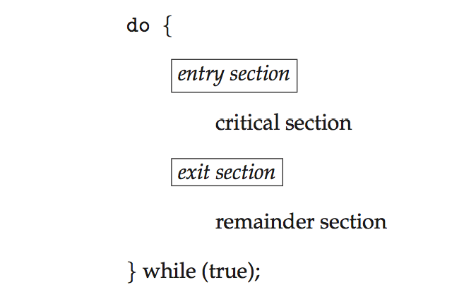
Critical Section
General structure of process P_{i}

Slide 8
Algorithm for Process P_{i}
do {
while (turn == j);
critical section
turn = j;
remainder section
} while (true);
Notes:
‹#›

Slide 9
Solution to Critical-Section Problem
1. Mutual Exclusion - If process P_{i} is executing in its critical section, then no other processes can be executing in their critical sections
2. Progress - If no process is executing in its critical section and there exist some processes that wish to enter their critical section, then the selection of the processes that will enter the critical section next cannot be postponed indefinitely
3. Bounded Waiting - A bound must exist on the number of times that other processes are allowed to enter their critical sections after a process has made a request to enter its critical section and before that request is granted
Assume that each process executes at a nonzero speed
No assumption concerning relative speed of the n processes
Notes:
‹#›

Slide 10
Peterson’s Solution
Good algorithmic description of solving the problem
Two process solution
Assume that the load and store machine-language instructions are atomic; that is, cannot be interrupted
The two processes share two variables:
int turn;
Boolean flag[2]
The variable turn indicates whose turn it is to enter the critical section
The flag array is used to indicate if a process is ready to enter the critical section. flag[i] = true implies that process P_{i} is ready!
Notes:
‹#›

Slide 11
Algorithm for Process P_{i}
do {
flag[i] = true;
turn = j;
while (flag[j] && turn = = j);
critical section
flag[i] = false;
remainder section
} while (true);
Notes:
‹#›

Slide 12
Peterson’s Solution (Cont.)
Provable that the three Critical Section(CS) requirement are met:
1. Mutual exclusion is preserved
P_{i} enters CS only if:
either flag[j] = false or turn = i
2. Progress requirement is satisfied
3. Bounded-waiting requirement is met
Notes:
‹#›

Slide 13
Synchronization Hardware
Many systems provide hardware support for implementing the critical section code.
All solutions below based on idea of locking
Protecting critical regions via locks
Uniprocessors – could disable interrupts
Currently running code would execute without preemption
Generally too inefficient on multiprocessor systems
Operating systems using this not broadly scalable
Modern machines provide special atomic hardware instructions
Atomic = non-interruptible
Either test memory word and set value
Or swap contents of two memory words
Notes:
‹#›

Slide 14
Solution to Critical-section Problem Using Locks
do {
acquire lock
critical section
release lock
remainder section
} while (TRUE);

Slide 15
test_and_set Instruction
Definition:
boolean test_and_set (boolean *target)
{
boolean rv = *target;
*target = TRUE;
return rv:
}
Executed atomically
Returns the original value of passed parameter
Set the new value of passed parameter to “TRUE”.
Notes:
‹#›

Slide 16
Solution using test_and_set()
Shared Boolean variable lock, initialized to FALSE
Solution:
do { while (test_and_set(&lock))
; /* do nothing */
/* critical section */
lock = false;
/* remainder section */
} while (true);
Notes:
‹#›

Slide 17
compare_and_swap Instruction
Definition:
int compare _and_swap(int *value, int expected, int new_value) {
int temp = *value;
if (*value == expected)
*value = new_value;
return temp;
}
Executed atomically
Returns the original value of passed parameter “value”
Set the variable “value” the value of the passed parameter “new_value” but only if “value” ==“expected”. That is, the swap takes place only under this condition.
Notes:
‹#›

Slide 18
Solution using compare_and_swap
Shared integer “lock” initialized to 0;
Solution:
do { while (compare_and_swap(&lock, 0, 1) != 0)
; /* do nothing */
/* critical section */
lock = 0;
/* remainder section */
} while (true);
Notes:
‹#›

Slide 19
Mutex Locks
Previous solutions are complicated and generally inaccessible to application programmers
OS designers build software tools to solve critical section problem
Simplest is mutex lock
Protect a critical section by first acquire() a lock then release() the lock
Boolean variable indicating if lock is available or not
Calls to acquire() and release() must be atomic
Usually implemented via hardware atomic instructions
But this solution requires busy waiting
This lock therefore called a spinlock
Notes:
‹#›

Slide 20
acquire() and release()
acquire() { while (!available)
; /* busy wait */
available = false;;
}
release() {
available = true;
}
do {
acquire lock
critical section
release lock
remainder section
} while (true);

Slide 21
Semaphore
Synchronization tool that provides more sophisticated ways (than Mutex locks) for process to synchronize their activities.
Semaphore S – integer variable
Can only be accessed via two indivisible (atomic) operations
wait() and signal()
Originally called P() and V()
Definition of the wait() operation
wait(S) {
while (S <= 0)
; // busy wait
S--;
}
Definition of the signal() operation
signal(S) {
S++;
}
Notes:
‹#›

Slide 22
Semaphore Usage
Counting semaphore – integer value can range over an unrestricted domain
Binary semaphore – integer value can range only between 0 and 1
Same as a mutex lock
Can solve various synchronization problems
Consider P₁ and P₂ that require S₁ to happen before S₂
Create a semaphore “synch” initialized to 0
P1:
S₁;
signal(synch);
P2:
wait(synch);
S₂;
Can implement a counting semaphore S as a binary semaphore
Notes:
‹#›

Slide 23
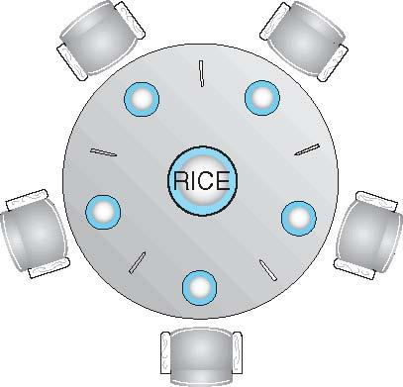
Dining-Philosophers Problem
Philosophers spend their lives alternating thinking and eating
Don’t interact with their neighbors, occasionally try to pick up 2 chopsticks (one at a time) to eat from bowl
Need both to eat, then release both when done
In the case of 5 philosophers
Shared data
Bowl of rice (data set)
Semaphore chopstick [5] initialized to 1
Notes:
‹#›

Slide 24
Dining-Philosophers Problem Algorithm
The structure of Philosopher i:
do {
wait (chopstick[i] );
wait (chopStick[ (i + 1) % 5] );
// eat
signal (chopstick[i] );
signal (chopstick[ (i + 1) % 5] );
// think
} while (TRUE);
What is the problem with this algorithm?
Notes:
‹#›

Slide 25
Dining-Philosophers Problem Algorithm (Cont.)
Deadlock handling
Allow at most 4 philosophers to be sitting simultaneously at the table.
Allow a philosopher to pick up the forks only if both are available (picking must be done in a critical section.
Use an asymmetric solution -- an odd-numbered philosopher picks up first the left chopstick and then the right chopstick. Even-numbered philosopher picks up first the right chopstick and then the left chopstick.
Notes:
‹#›

Slide 26
Problem with dining philosopher algorithm
The problem arises when all five philosophers are hungry and try to pick up their left and right chopsticks at the same time. If this happens, each philosopher will be holding one chopstick and waiting for the other chopstick from their neighbor. This creates a deadlock situation, where no philosopher can eat and the system will eventually crash.

Slide 27
End of Chapter 5
Notes:
‹#›

